Slide 1



“DECISION MAKING USING SOFT SET AND ROUGH SET ON INTUITIONISTIC FUZZY APPROXIMATION SPACE”
TEAM MEMBERS
TANMAY BORSE
ARPIT MADSE
ADITI ACHARJYA
24MCS0001
24MCS0042
24MCS0062
GUIDED BY
Dr. GEETHA MARY A

Slide 2


MSET695J
PROJECT WORK

Slide 3

OUTLINE
01
INTRODUCTION
05
PROPOSED DECISION MAKING MODEL
02
LITERATURE REVIEW
06
EXPERIMENTAL STUDY
03
ROUGH SET ON INTUITIONISTIC FUZZY APPROXIMATION SPACE
07
RESULT ANALYSIS
08
CONCLUSION
04
SOFT SET AND LIMITATIONS
09
REFERENCES AND CITATION

Slide 4

INTRODUCTION
In the current era of the internet, a vast amount of data is accessible in many different fields. Because of this, it is extremely difficult to glean meaningful information from the vast amount of data that exists in the universe. Thus, among the most prominent fields of study in recent years have been decision making, knowledge representation, and information retrieval.
The majority of our conventional tools are exact, deterministic, and incisive. However, a lot of real-world issues that arise from engineering, economics, and social science are not necessarily clear-cut with an abundance of uncertainties.
The theory of probability, fuzzy sets, intuitionistic fuzzy sets, rough sets, fuzzy rough sets, as well as rough sets on fuzzy approximation spaces and intuitionistic fuzzy approximation spaces, are some of the key theories that address uncertainty.

Slide 5


LITERATURE REVIEW
S.No. | Title of the Paper | Author | Inferences | Drawbacks
1 | A Decision Making Model Using Soft Set and Rough Set on Fuzzy Approximation Spaces | T.K. Das and D.P. Acharjya (2014) | Proposes a model for decision-making using combined soft set and rough set theories within fuzzy approximation spaces, enhancing accuracy in handling uncertainties. | Limited practical application examples and lacks performance analysis in complex decision-making scenarios.
2 | A Study on Rough Set Models | Y.Y. Yao and Y. Zhao (2005) | Analyzes various rough set models and their applications in data analysis and decision support, with a focus on model efficiency and accuracy. | Theoretical analysis is extensive but lacks empirical testing for model validation.

Slide 6
LITERATURE REVIEW
S.No. | Title of the Paper | Author | Inferences | Drawbacks
3 | Fuzzy Decision-Making Based on Rough Sets, Intuitionistic Fuzzy Sets, and Soft Sets | S.M. Chen and L.W. Lee (2010) | Combines fuzzy sets, rough sets, and soft sets for a comprehensive decision-making framework, enhancing flexibility and adaptability in uncertain environments. | Complexity in implementation due to integration of multiple theories; requires significant computational resources.
4 | Rough Sets on Intuitionistic Fuzzy Approximation Spaces | B.K. Tripathy (2006) | Extends rough set theory to intuitionistic fuzzy approximation spaces, allowing better handling of imprecision in data classification. | Limited application scope and lacks a comparison with other fuzzy and rough set integration methods.

Slide 7
LITERATURE REVIEW
S.No. | Title of the Paper | Author | Inferences | Drawbacks
5 | Intuitionistic Fuzzy Sets | K.T. Atanassov (1986) | Introduces intuitionistic fuzzy sets (IFS) to address both membership and non-membership, improving decision support in fuzzy environments. | Initial model lacks adaptability to real-time decision-making and has limited scalability.
6 | Rough Sets | Z. Pawlak (1982) | Introduces rough set theory as a mathematical tool to address data uncertainty, particularly useful in classification and decision analysis. | Basic model doesn’t handle noisy data well and requires extension for handling partial membership (fuzziness).

Slide 8
LITERATURE REVIEW
S.No. | Title of the Paper | Author | Inferences | Drawbacks
7 | An Application of Soft Sets in a Decision-Making Problem | P.K. Maji, A.R. Roy, and R. Biswas (2001) | Demonstrates a practical application of soft sets in decision-making, showcasing their ability to handle vagueness in criteria selection. | Narrow focus on specific decision-making cases; lacks a comprehensive framework for general application.
8 | Soft Set Theory and Its Applications | D. Molodtsov (1999) | Introduces soft set theory as a mathematical tool to address uncertainty, offering flexibility in multi-criteria decision-making problems. Highlights applications in various fields like economics and engineering. | The theoretical foundation is strong, but lacks detailed methodologies for practical implementation in decision-making.

Slide 9
LITERATURE REVIEW
S.No. | Title of the Paper | Author | Inferences | Drawbacks
9 | A Rough Set Approach to Decision Making in Multicriteria Environments | Pawel W. Kaczmarek, Zbigniew W. Raubo (2019) | It provides a framework for modeling decision-making processes by using rough sets to reduce the dimensionality of decision criteria. | It may not be easily applicable to all types of decision-making problems, particularly those with highly complex criteria or interdependencies among criteria.
10 | A Novel Approach to Decision-Making Based on Soft Rough Sets and Fuzzy Sets | Z.Z. Deng, S.J. He, and X.Y. Hu (2009) | Develops a decision-making model integrating soft rough sets with fuzzy sets to improve the precision of decision outcomes in complex systems. | Complexity of the hybrid model increases computational requirements, making it less efficient for real-time applications.

Slide 10

ROUGH SET ON INTUITIONISTIC FUZZY APPROXIMATION SPACE
For membership and non-membership functions related to an intuitionistic fuzzy set, we use the conventional notation µ(z) and v(z), respectively. Let Z be the universe of a finite collection of items that are not empty. An intuitionistic fuzzy relation on Z is an intuitionistic fuzzy subset of (Z x Z) .
An intuitionistic fuzzy proximity relation R on Z is an intuitionistic fuzzy proximity relation that satisfies the condition:
Reflexivity: µ(z , z) = 1 ; v(z , z) = 0 for all z ∈ Z
Symmetric: µ(z1 , z2) = µ(z2 , z1) ; v(z1 , z2) = v(z2, z1) for all z1, z2 ∈ Z

Slide 11
SOFT SET AND LIMITATION
Soft Set is a data mining technique facilitates decision-making. However, it has some constraints. An information system , where U is a set of objects (Here Institutions) and E (say infrastructure, placement, extra curricular etc.) is a set of parameters, is considered in this application.
According to reasoning, an item can only be a part of a parameter if it completely satisfies it. On the other side, the object does not belong to the parameter if it does not satisfy it. As a result, the parameter value can only be between 0 and 1.
However, it is frequently noted that an information system is quantitative rather than qualitative in real-world scenarios

Slide 12
COUNTINUE...
We suggest a decision-making paradigm with two processes, such as pre-process and post-process, to get over this constraint.
In pre-processing, we find the nearly equivalence of objects given a parameter using rough sets on intuitionistic fuzzy approximation spaces. To get decisions in post-process, we employ soft set approaches

Slide 13
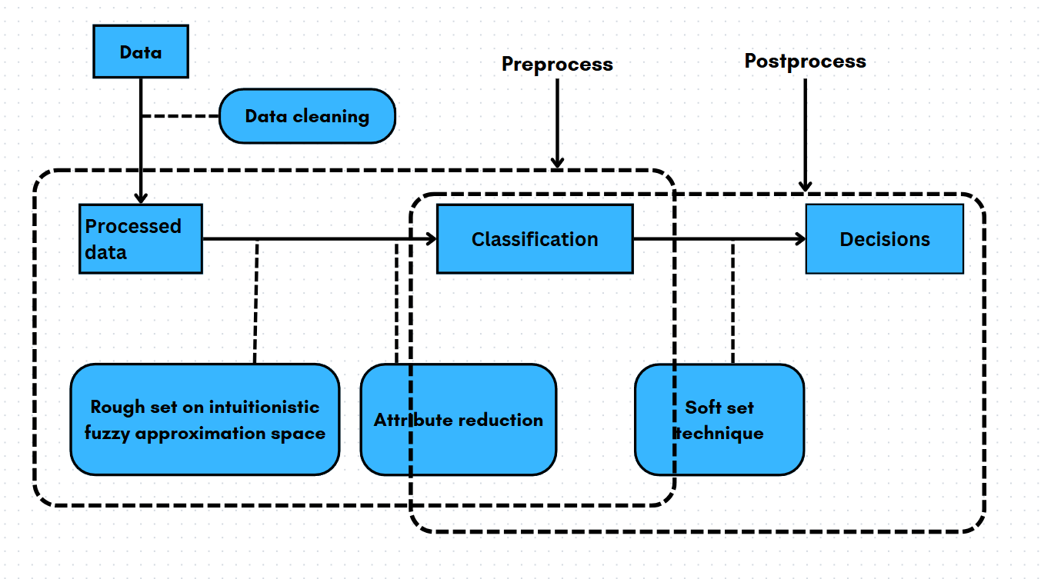
PROPOSED DESICION MAKING MODEL

Slide 14
COUNTINUE...
In preprocess, we use a rough set on intuitionistic fuzzy approximation space to process the quantitative data after it has been cleaned. The number of attributes that have no influence on the information database is further decreased by employing rough set reduction.
In the post-process, soft set techniques are utilized to mine information database decisions based on the classification that was achieved in the pre-process.

Slide 15
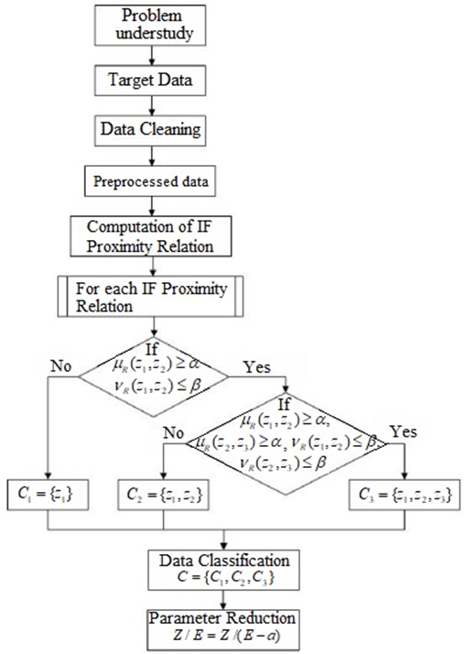
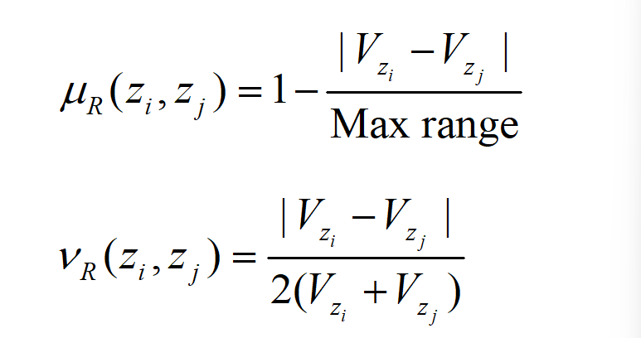
PREPROCESS OF PROPOSED DESIGN
These procedures include noise removal, consistency checks, and data completeness.
intuitionistic fuzzy (IF) proximity relations are used to calculate equivalence classes for each parameter.
We define an intuitionistic fuzzy proximity relation R(zi, zj) concerning the membership and non-membership functions as defined below.

Slide 16
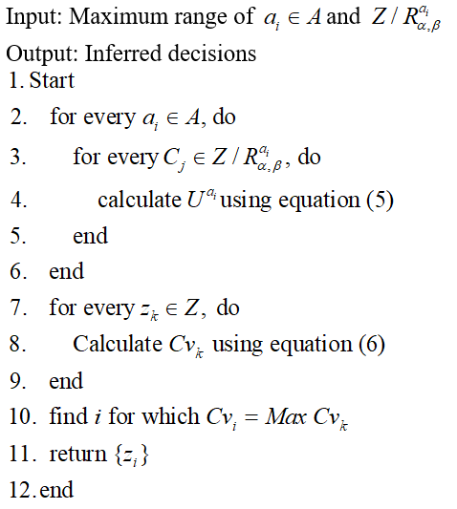
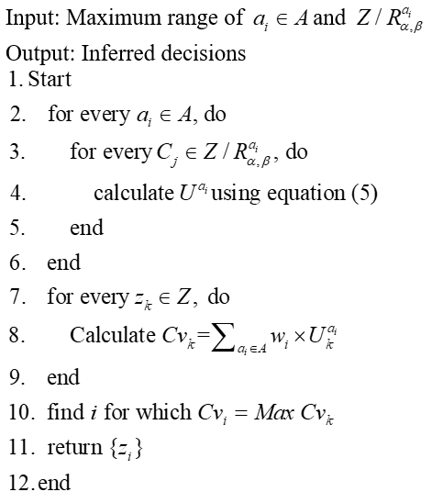
POSTPROCESS DESIGN
ALGORITHM 1: STRAIGHTFORWARD DECISION MAKING ALGORITHM
ALGORITHM 2: WEIGHTED DECISION MAKING ALGORITHM

Slide 17


COUNTINUE...
EQUATIONS

Slide 18
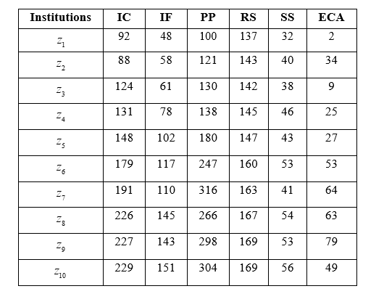
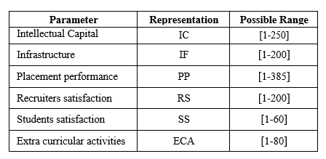
EXPERMENTAL STUDY
SAMPLE INFORMATION DATABASE
DESCRIPTION OF PARAMETERS

Slide 19
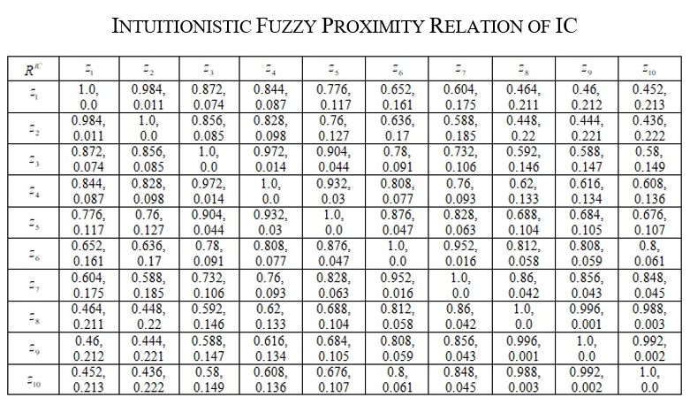
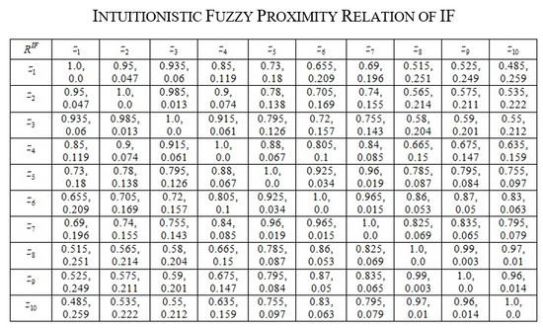
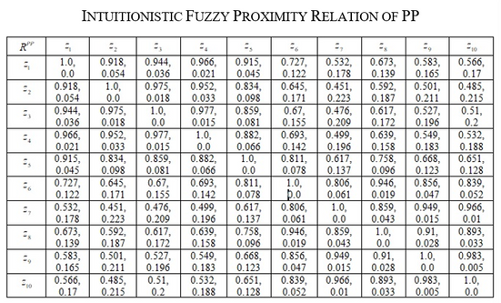
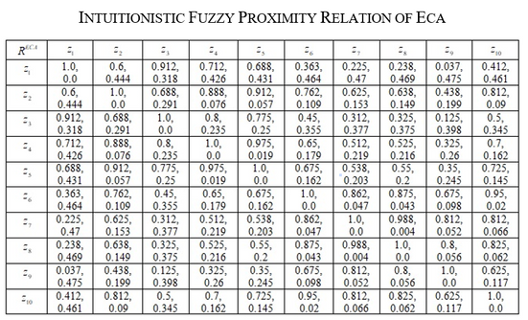
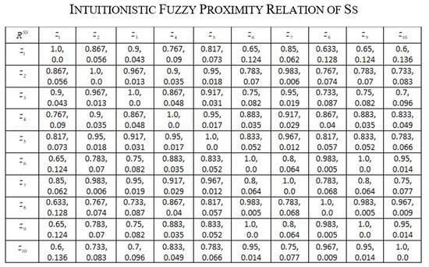
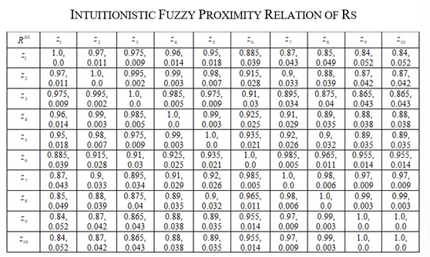
RESULT ANALYSIS

Slide 20
COUNTINUE...
The notation used for representing institutions are zi, i = 1,2,3,...,10.
Each parameter's intuitionistic fuzzy proximity relations are joined together to form (α,ß)- equivalence classes. The intuitionistic fuzzy proximity relations that correlate to the attributes Intellectual Capital (IC), Infrastructure Facilities (IF), Placement Performance (PP), Recruiters Satisfaction (RS), Student Satisfaction (SS), and Extra Curricular Activity (ECA) are calculated
We have consider the almost similarity of 92% (membership value), i.e., α >= 0.92. and dissimilarity value 6% (non-membership value) i.e. ß <= 0.06

Slide 21
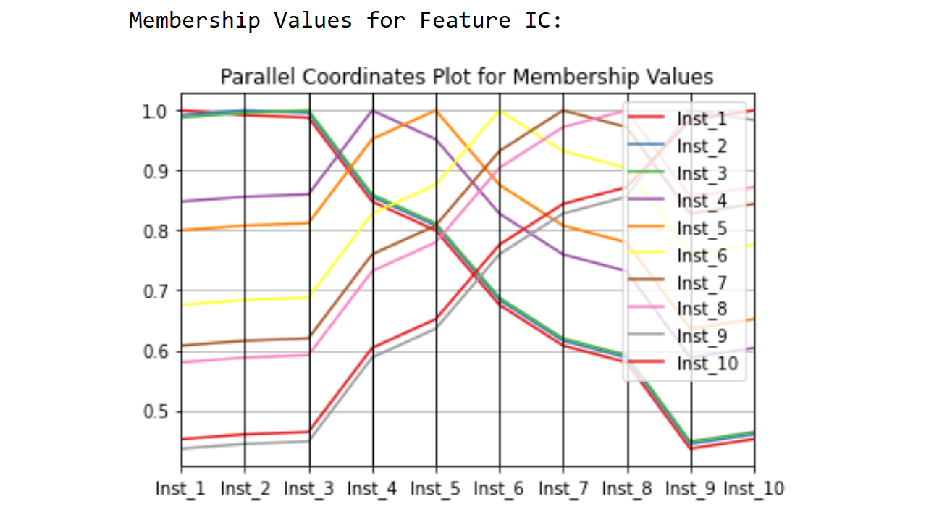
COUNTINUE...

Slide 22
FUZZY GROUPS
Fuzzy group for feature IC:
{ {Inst_1, Inst_2, Inst_3}, {Inst_4, Inst_5}, {Inst_6, Inst_7, Inst_8}, {Inst_9, Inst_10} }
Fuzzy group for feature IF:
{ {Inst_1, Inst_2, Inst_3}, {Inst_4, Inst_5, Inst_6}, {Inst_7}, {Inst_8, Inst_9, Inst_10} }
Fuzzy group for feature PP:
{ {Inst_1, Inst_2, Inst_4}, {Inst_3, Inst_5}, {Inst_6}, { Inst_7, Inst_8, Inst_9, Inst_10} }

Slide 23
COUNTINUE...
Fuzzy group for feature RS:
{ {Inst_1, Inst_2, Inst_3, Inst_4, Inst_5, Inst_6, Inst_7, Inst_8, Inst_9, Inst_10} }
Fuzzy group for feature SS:
{ {Inst_1, Inst_2, Inst_3, Inst_5}, {Inst_4 Inst_6 Inst_7 Inst_8, Inst_9}, {Inst_10} }
Fuzzy group for feature ECA:
{ {Inst_1, Inst_5}, {Inst_2}, {Inst_3, Inst_4}, {Inst_6, Inst_7}, {Inst_8}, {Inst_9}, {Inst_10} }

Slide 24
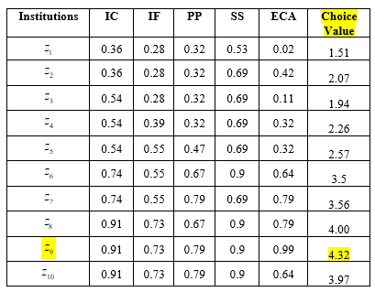
POSTPROCESS ANALYSIS
PROPOSED STRAIGHTFORWARD DECISION MAKING

Slide 25
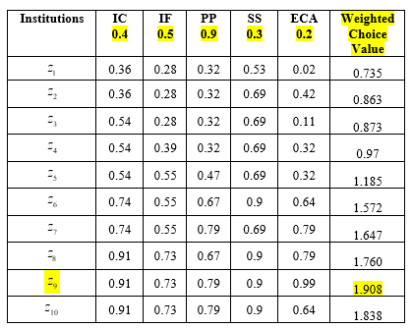
COUNTINUE...
PROPOSED WEIGHTED DECISION MAKING

Slide 26
CONCLUSION
This project presents an innovative approach to decision-making in uncertain environments by integrating soft sets, rough sets, and intuitionistic fuzzy sets. Together, these mathematical tools enable flexible, precise, and robust handling of ambiguous data, which traditional decision-making models often fail to address effectively.
Moving forward, this approach could be refined and applied across various fields, leading to enhanced decision-making processes and advancements in both technology and societal well-being.

Slide 27
REFERENCES
https://www.aimspress.com/article/10.3934/mbe.2020321
https://www.sciencedirect.com/science/article/pii/S0898122111009138
https://content.iospress.com/articles/journal-of-intelligent-and-fuzzy-systems/ifs1010
https://en.wikipedia.org/wiki/Rough_set
https://link.springer.com/article/10.1007/s11047-018-9700-3

Slide 28
CITATION
1. Das, T. K., & Acharjya, D. P. (2014). A decision-making model using soft set and rough set on fuzzy approximation spaces. International Journal of Intelligent Systems Technologies and Applications, 13(4), 364-377.
https://doi.org/10.1504/IJISTA.2014.065836
2. Yao, Y. Y., & Zhao, Y. (2005). A study on rough set models. International Journal of Approximate Reasoning, 41(1), 1-16.
https://doi.org/10.1016/j.ijar.2005.02.006
3. Chen, S. M., & Lee, L. W. (2010). Fuzzy decision-making based on rough sets, intuitionistic fuzzy sets, and soft sets. Information Sciences, 180(3), 389-406.
https://doi.org/10.1016/j.ins.2009.10.004

Slide 29
4. Tripathy, B. K. (2006). Rough sets on intuitionistic fuzzy approximation spaces. In Proceedings of the IEEE Conference on Intelligent Systems (Vol. 1, pp. 202-207).
https://doi.org/10.1109/IS.2006.348408
5. Atanassov, K. T. (1986). Intuitionistic fuzzy sets. Fuzzy Sets and Systems, 20(1), 87-96.
https://doi.org/10.1016/S0165-0114(86)80034-3
6. Pawlak, Z. (1982). Rough sets. International Journal of Information and Computer Sciences, 11(5), 341-356.
https://doi.org/10.1007/BF01001956

Slide 30
7. Maji, P. K., Roy, A. R., & Biswas, R. (2001). An application of soft sets in a decision-making problem. Computers & Mathematics with Applications, 44(8-9), 1077-1083.
https://doi.org/10.1016/S0898-1221(02)00232-1
8. Molodtsov, D. (1999). Soft set theory—First results. Computers & Mathematics with Applications, 37(4-5), 19-31.
https://doi.org/10.1016/S0898-1221(99)00056-8
9. Deng, Z. Z., He, S. J., & Hu, X. Y. (2009). A novel approach to decision-making based on soft rough sets and fuzzy sets. Applied Soft Computing, 9(3), 760-765.
https://doi.org/10.1016/j.asoc.2008.09.005
10. Shabir, P., & Naz, M. (2013). An overview of soft set, rough set, and fuzzy set theories. Journal of Fuzzy Mathematics, 21(3), 747-760.

Slide 31


THANK YOU

